Slide 1



SMART INDIA HACKATHON 2026
TITLE PAGE
Problem Statement ID: SIH26130
Problem Statement Title: Efficiency in Streamlining Industrial Approvals, Compliance Processes, and Access to Government Support Services
Theme: Miscellaneous
PS Category: Software
Team ID :
Team Name : CodeXMinds

Slide 2
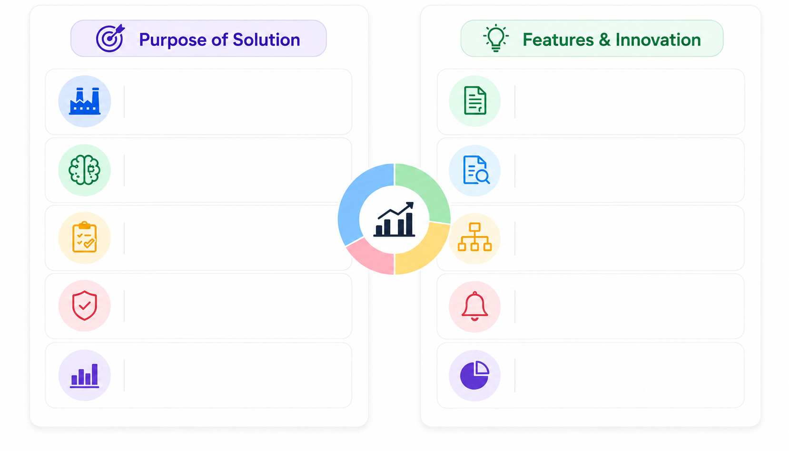
IDEA TITLE
CodeXMinds
Single platform for industrial approvals & compliance.
Automated checklist for approvals & compliance.
Al assistant for rules, documents & query support.
Smart document verification & validation.
Smart tracking of approvals, deadlines & dependencies.
Approval dependency mapper & workflow.
Ensures compliance & faster decision making.
Real-time SLA tracking & alerts.
Data-driven insights for better governance.
Unified dashboard with analytics & reports.
@SIH Idea submission- Template
2
Notes:
2

Slide 3
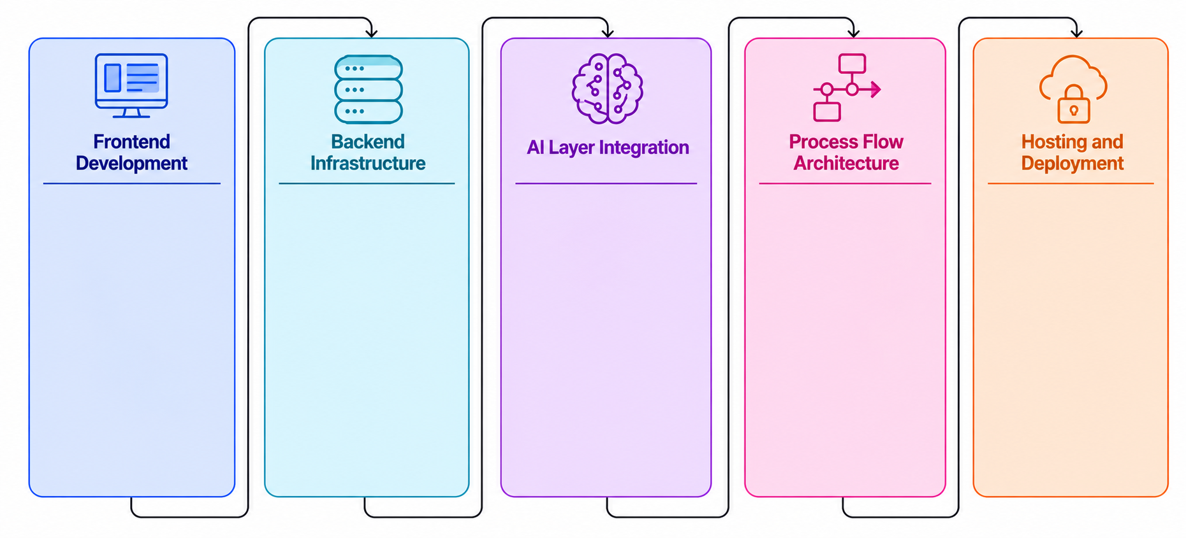
TECHNICAL APPROACH
CodeXMinds
* React.js for investor and government dashboards with responsive,enterprise-grade UI.
* Java and Spring Boot for
REST APIs,business logic
,authentication,and
application workflow.
* OLLM API and RAG for - document processing, knowledge base, and information retrieval.
* Applications received via company profile are processed through Spring Boot APIs, Rules Engine and regulatory database to identify required approvals, dependencies, compliance requirements and eligible government schemes.
* Cloud deployment with HTTPS and JWT security.
* Tailwind CSS for modern and consistent interface.
* Managed MySQL database.
* MySQL with JPA/Hibernate for company data,applications, approvals and compliance regulatory records.
* Al features including Regulatory Assistant, Compliance Assistant, PDF Document Intelligence, Information Extraction, and Document Mismatch Detection.
* React flow for approval dependency visualization.
* AI/RAG provides source-backed explanations and document intelligence.
* REST-based service integration.
* Recharts for government analytics and dashboard.
* JWT for secure, role-based access.
* End-to-end workflow ensures faster, transparent and traceable clearances.
Notes:
3

Slide 4
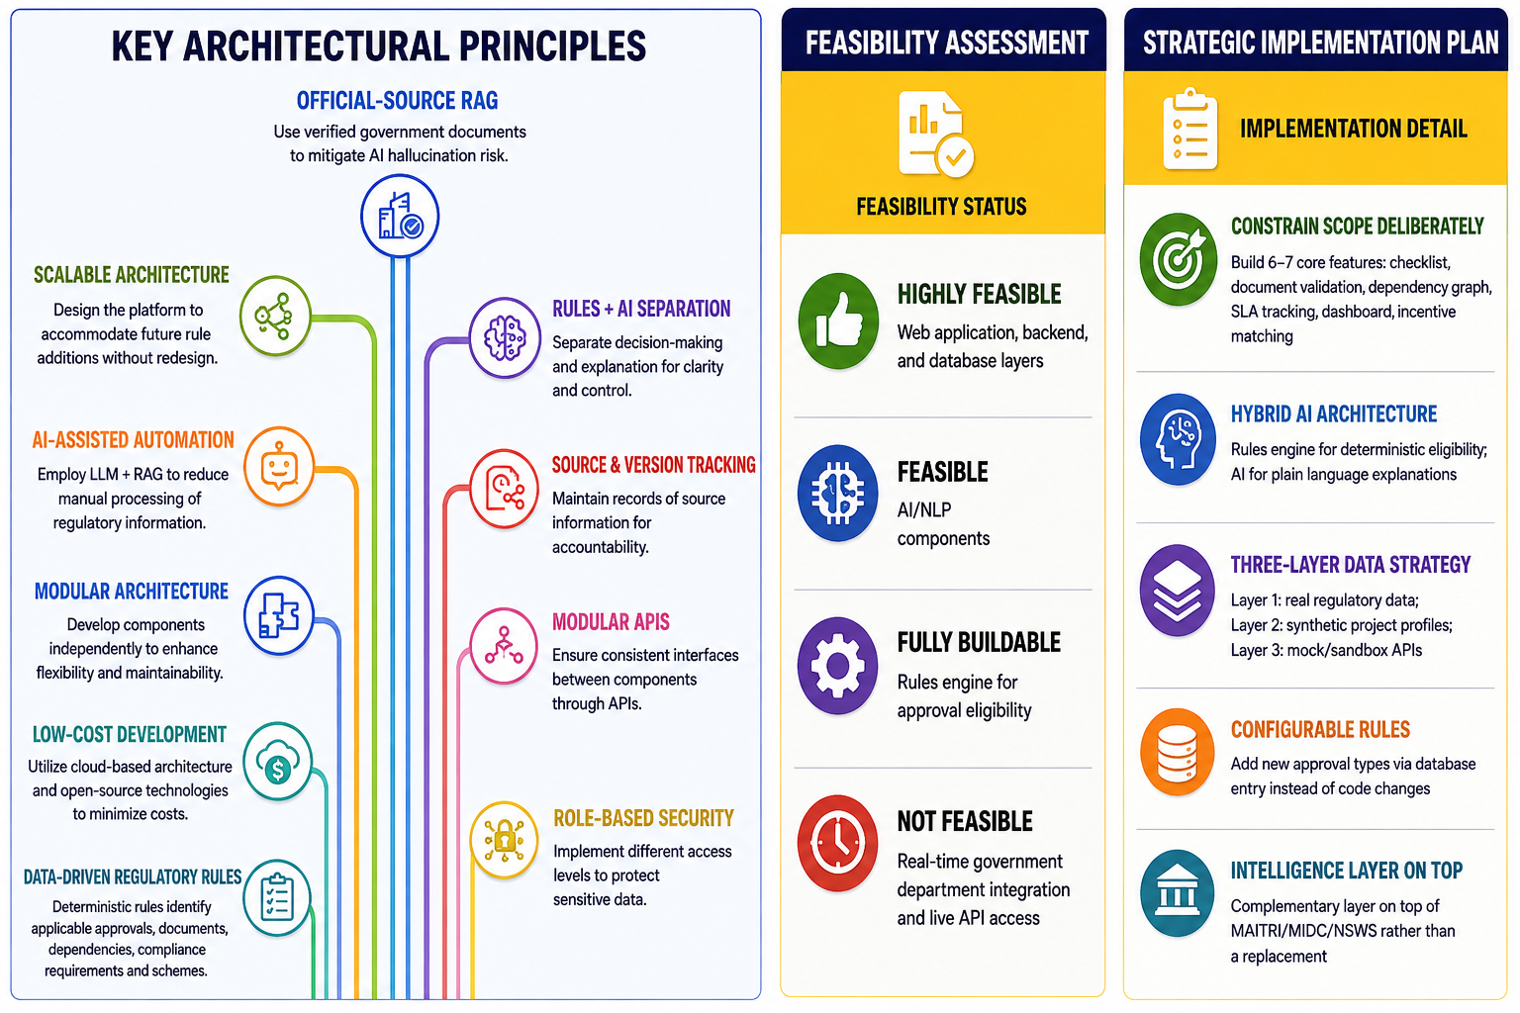
CodeXMinds
FEASIBILITY AND VIABILITY
@SIH Idea submission- Template
Notes:
4

Slide 5
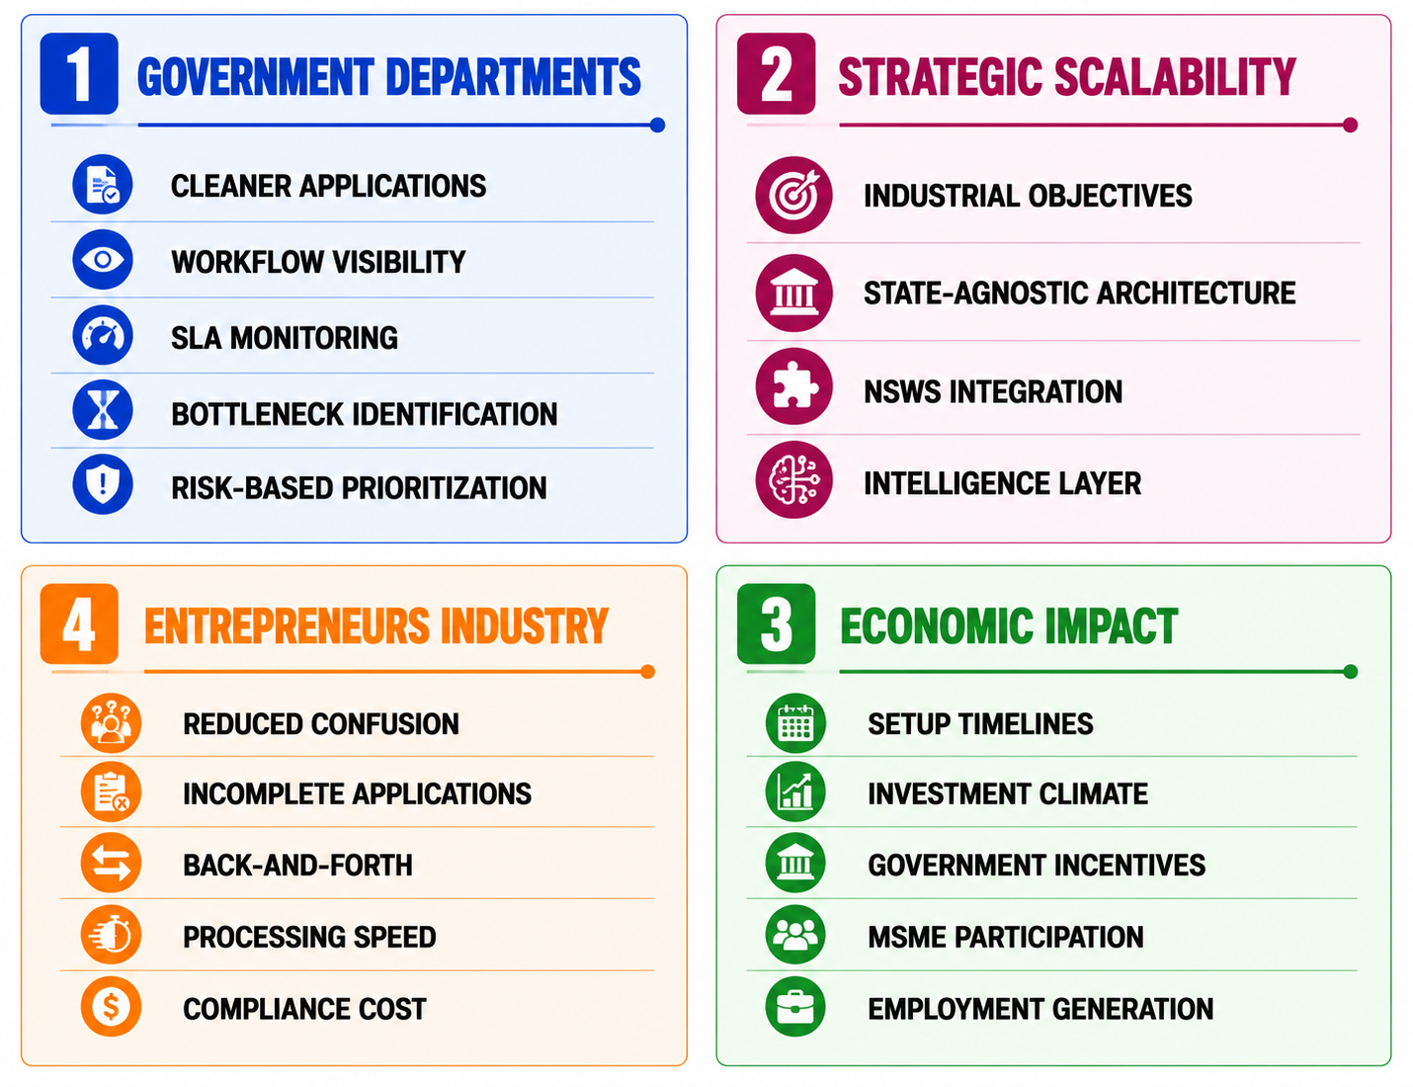
CodeXMinds
IMPACT AND BENEFITS
5
Notes:
5

Slide 6
RESEARCH AND REFERENCES
CodeXMinds
NSWS: nsws.gov.in
MAITRI: maitri.mahaonline.gov.in
MIDC: midc.maharashtra.gov.in
RAG Paper: Lewis et al., 2020
LayoutLM Paper: Xu et al., 2020
6
Notes:
6

